Slide 1
Intermediate Machine Learning Opencampus

Slide 2

PetFinder.my - Pawpularity Contest Kaggle Challenge
CHRISTOPHER KUNZE
KHUSHI KALA

Slide 3
INTRODUCTION
Project (Kaggle Competition): PetFinder.my - Pawpularity Contest
About: PetFinder.my is Malaysia’s leading animal welfare platform, featuring over 180,000 animals with 54,000 happily adopted. PetFinder collaborates closely with animal lovers, media, corporations, and global organizations to improve animal welfare.
Objective: The main objective of the Project is to analyze raw images and metadata to predict the “Pawpularity Score” of pet photo.
Scope: Implementing deep learning with Pytorch and Transformers models to perform prediction using Images as the Input Data.
Application: This model can be use further into AI tools that will guide shelters and rescuers around the world to improve the appeal of their pet profiles, automatically enhancing photo quality and recommending composition improvements.
The Pawpularity Score is derived from each pet profile's page view statistics at the listing pages, using an algorithm that normalizes the traffic data across different pages, platforms (web & mobile) and various metrics. Duplicate clicks, crawler bot accesses and sponsored profiles are excluded from the analysis
Photo Metadata is manually labeling each photo for key visual quality and composition parameters
Link: https://www.kaggle.com/competitions/petfinder-pawpularity-score
Group Members: Christopher Kunze and Khushi Kala

Slide 4
Dataset Characteristics
Results achieved from Initial Data Analysis (IDA)
Metadata and Image Data (train.csv, test.csv, train jpg, test jpg)
The train dataset is of shape (9912, 14), i.e. 9912 instances (images and metadata) and 14 features.
The test dataset is of shape (8, 13), i.e. 8 instances and 13 features.
The target variable is Pawpularity Score which ranges from 1-100, depicting that there are some images with score as high as 100 and some with as low as 1 ( this can also be an outlier)
The dataset contains No Null and duplicate Values
The mean of target variable is 40
Metadata features are not highly correlated with the target variable
Total 288 images have pawpularity score = 100

Slide 5
Pipeline
Data Collection
Input: Images and Metadata
Output: Score (0-100)
Data Preprocessing
Resize images to 224x224
Normalize (mean = 0.5, std = 0.5)
Transformations
Data Loading
Splitting data in train and validation set
Using Dataloader for Batching
Feature Extraction
Different Models such as CNN, ResNet50, Transformers
Model Training
And Validation
Analyzing loss curves
Learning Rate Scheduler
ReduceLROnPlateau
Optimization
ADAMW optimizer
Loss Calculation
RMSE
Finetuning last layers in Transformers model
Cross Validation for final model
Finalizing Model

Slide 6
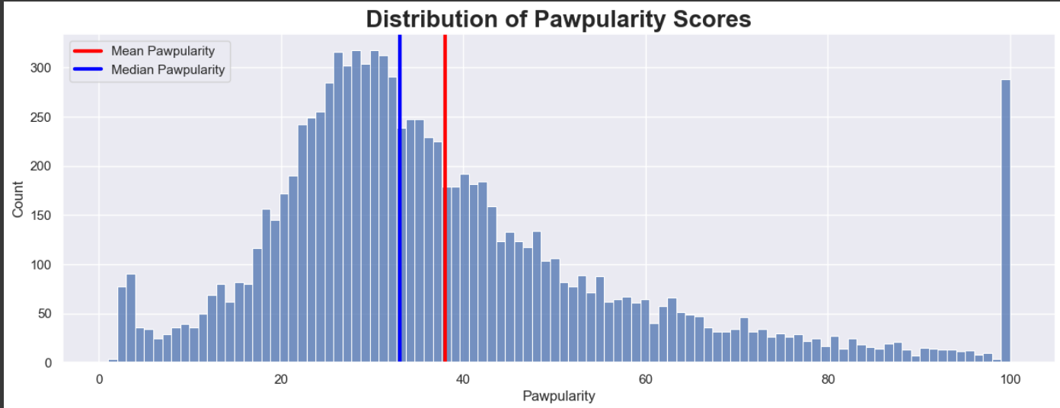
Dataset Characteristics
Results achieved from Exploratory Data Analysis (EDA)

Slide 7
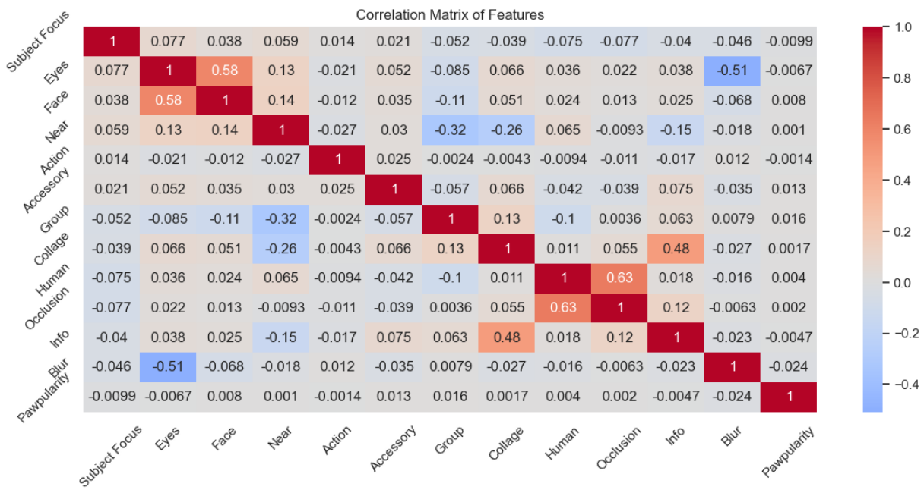
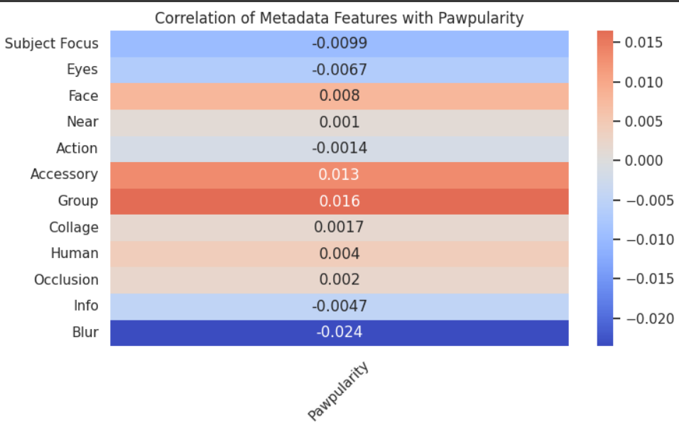
Correlation
Correlation Matrix
Correlation with Pawpularity (target)

Slide 8
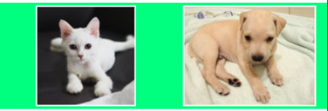
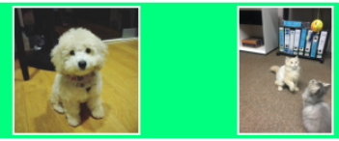
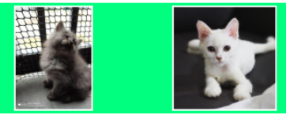
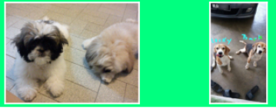
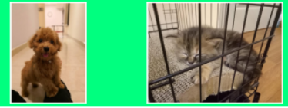
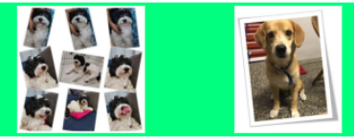
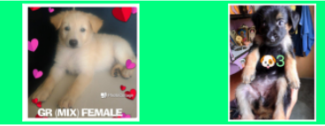
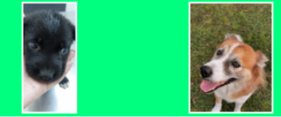
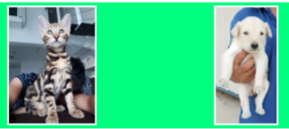
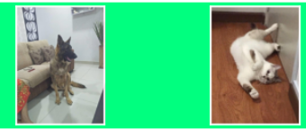
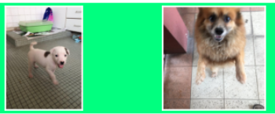
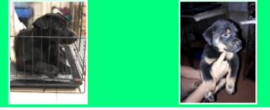
Dataset Images with Features
1. Subject
Focus
6. Accessory
2. Eyes
7. Group
11. Info
3. Face
8. Collage
4. Near
9. Human
12. Blur
5. Action
10. Occlusion

Slide 9
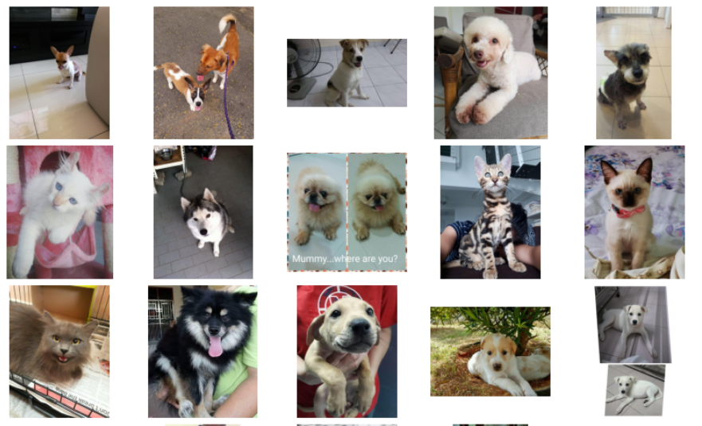
Pawpularity Score = 100

Slide 10
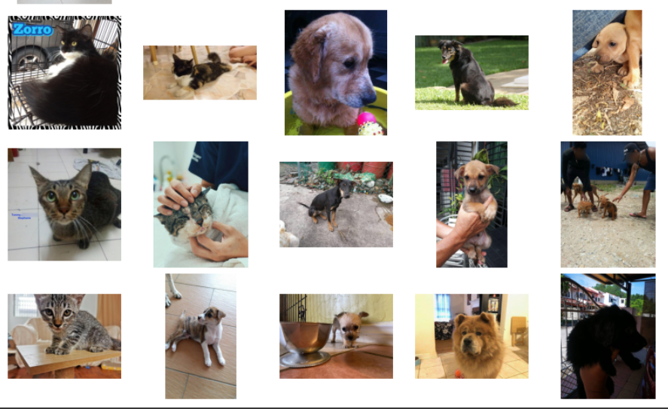
Pawpularity Score < 3

Slide 11
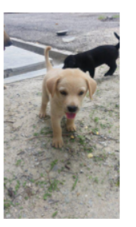
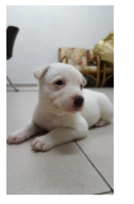
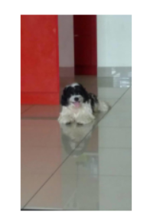
Data Augmentation
Data augmentation is useful to improve performance and outcomes of machine learning models by forming new and different examples to train datasets.
Transforms are done using Compose. Computer Vision Transformations (CV2)
The transforms operations are applied to the original images at every batch generation. So the dataset is left unchanged, only the batch images are copied and transformed every iteration.
Original with no Transformation:

Slide 12
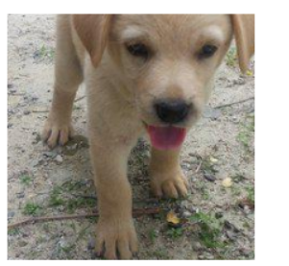
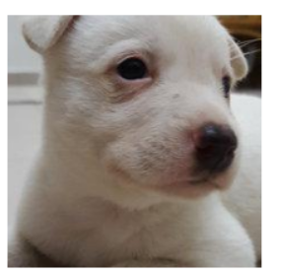
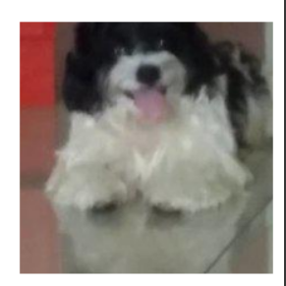
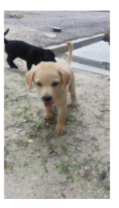
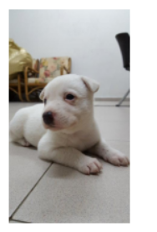
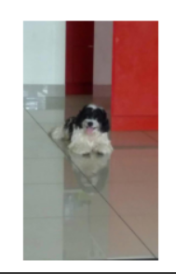
Examples of Data Transformation
Center Crop Transformation:
Horizontal Flip

Slide 13
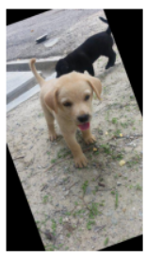
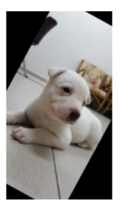
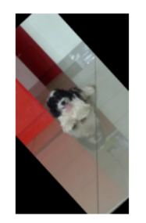
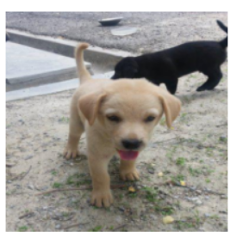
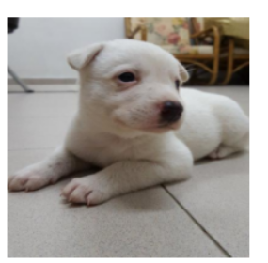
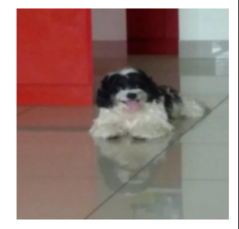
Examples of Data Transformation
Rotation 45 degrees
Random Crop

Slide 14
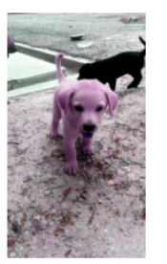
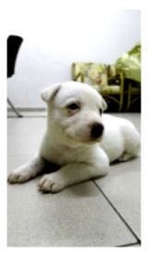
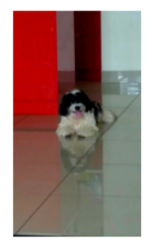
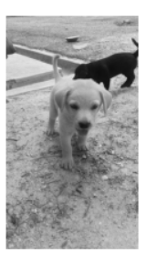
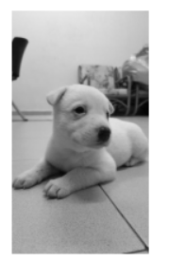
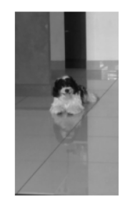
Examples of Data Transformation
Color Jitter:
Grayscale

Slide 15
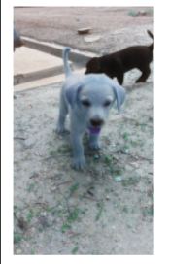
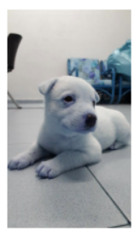
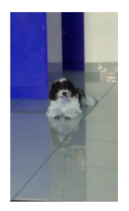
Examples of Data Transformation
Color Space: Alpha Channel (RGBA)
What happens when we apply data transformation in Pytorch?
Steps for training set
Resizing is applied
For the transformation to be applied or not to the patch is a chance (50/50)
Convert it to a tensor
Normalize the resulting tensor
2. Steps for validation set
Resizing is applied to the image
Convert it to a tensor
Normalizing the resulting tensor

Slide 16
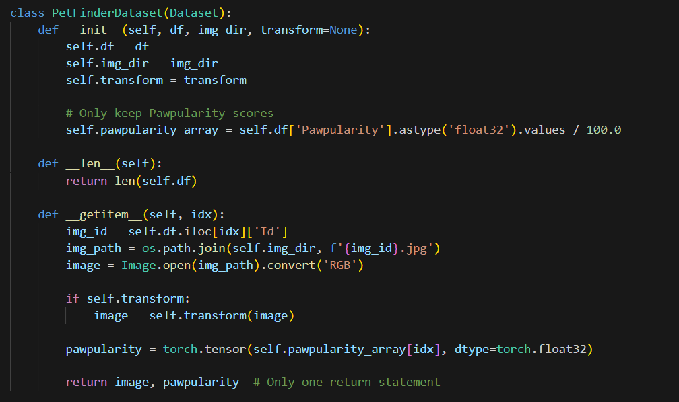
Dataset Creation with Images
The Class contains Target Value as Pawpularity Scores and the Input data are the images
Code Below:

Slide 17
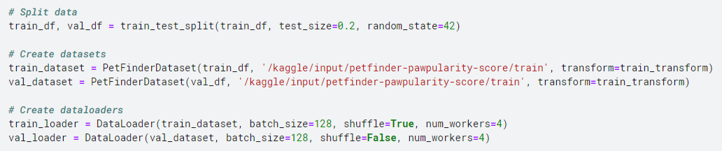
Train-Validation Split
1. Train-Validation (80%-20%) on Train dataset using train_test_split from sklearn library
2. Using Dataloader class from Pytorch to perform training in batches of Batch Size = 128
3. Creating train_loader with Shuffle = True so as to keep off the Pattern learning by model through a sequence.
Code Below:

Slide 18
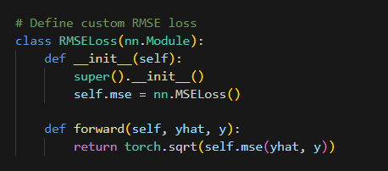
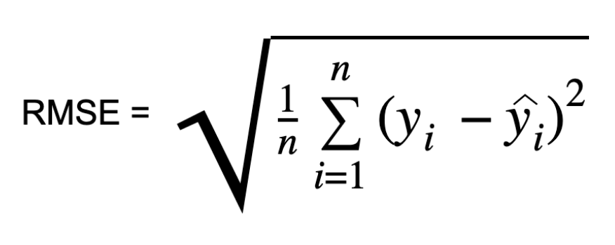
Evaluation Metric
RMSE : Root Mean Square Error (Method prescribed in the competition)
RMSE represents the square root of the average squared differences between predicted and observed outcomes. RMSE value with zero indicates that the model has a perfect fit. The lower the RMSE, the better the model and its predictions. A higher relative root mean square error in machine learning indicates that there is a large deviation from the residual to the ground truth.

Slide 19
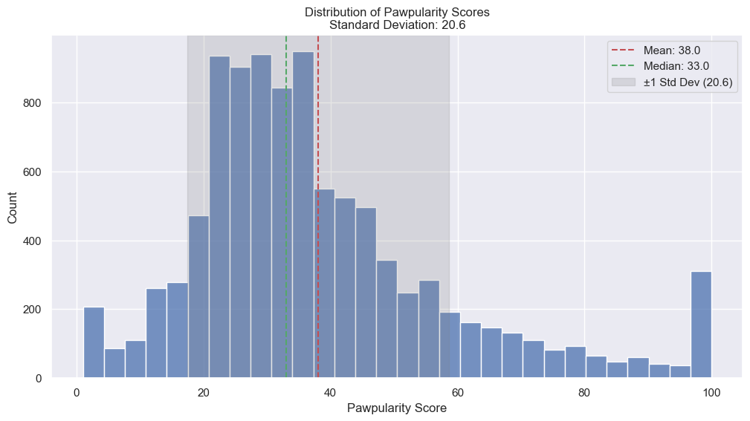
Baseline “Model”
Baseline RMSE: (As per Challenge)
Standard Deviation = 20.6
If we put all our pawpulartiy scores
to mean that is 38.0,
then we will have the RMSE of 20.6
Therefore,
Goal RMSE: <20.6
Source: https://www.kaggle.com/competitions/petfinder-pawpularity-score/discussion/301686

Slide 20
Research: Computer Vision Task
Models Implementation Sequence:
1. Convolutional Neural Network (CNN) Model: Represents Hierarchical Feature Learning in which Early layers detect edges/textures and the deeper layers capture complex patterns. CNNs remain optimal for tasks requiring local feature extraction and data efficiency. (spatial data)
2. ResNet50 Model (Based on ImageNet training Data): It is a 50-Layer CNN with bottleneck blocks. Incorporates Feature Extraction with Global Average Pooling → Custom classifier (Transfer learning, freezing the pre-trained model's weights). Weights version used in the project IMAGENET1K_V1
3. Vision Transformer (ViT): Represents Transformer architecture for images by splitting them into patches and processing via self-attention.
Paper: An Image is Worth 16x16 Words: Transformers for Image Recognition at Scale
4. Swin Transformer: Hierarchical ViT with shifted windows for efficient multi-scale processing. Shifted Window Attention is the Local self-attention within non-overlapping windows, with cross-window shifts.ViT/Swin excel in global context and scalability but demand more computational resources.
Paper: Hierarchical Vision Transformer using Shifted Windows
5. DeiT Transformer: Distillation-based training to reduce ViT's data dependency.
Paper: Training data-efficient image transformers & distillation through attention
6. OpenAI Clip Model: Multimodal Design with Image Encoder and Text Encoder. The main capability is to classify unseen categories using natural language prompts.

Slide 21
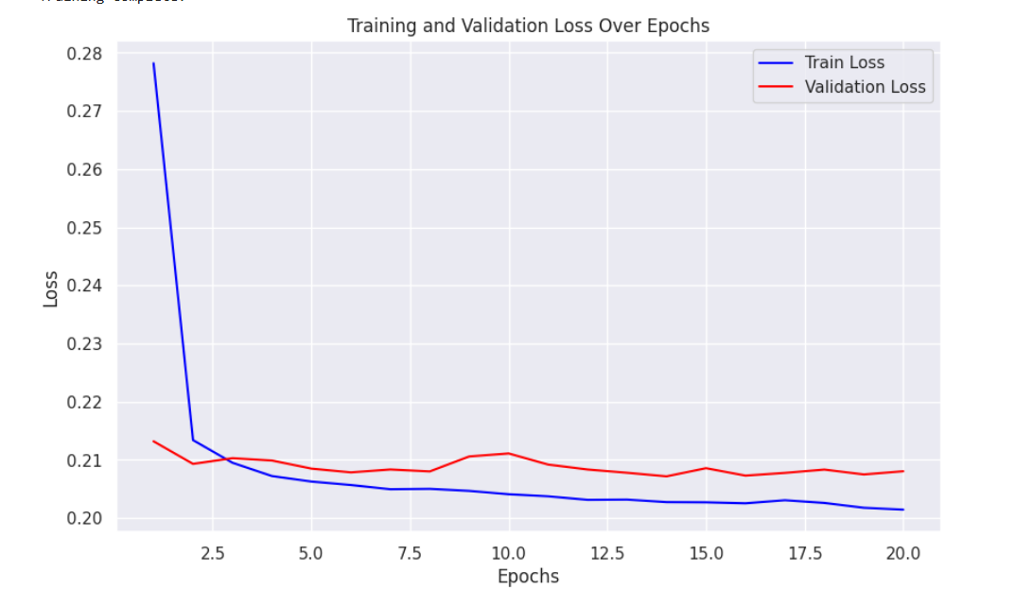
Multi-Layer Perceptron (MLP) with Metadata
Loss Graph: Training and Validation
MLP Model Details:
Number of Epochs = 20
Optimizer = AdamW
Learning Rate Scheduler = ReduceLROnPlateau
4. Loss Criteria = RMSE Loss
5. Activation Function = ReLU
MLP Model Architecture:
Input Layer (input_dim = 12 features)
↓
Fc1 - nn.Linear(input_dim, 128) → nn.BatchNorm1d(128) → ReLU → nn.Dropout(0.3)
↓
Fc2- nn.Linear(128, 64) → nn.BatchNorm1d(64) → ReLU
↓
Output Layer: nn.Linear(64, 1)
Results:
Training Loss:0.2027
Validation Loss:0.2072
RMSE of 20.72 > Baseline (20.6)

Slide 22
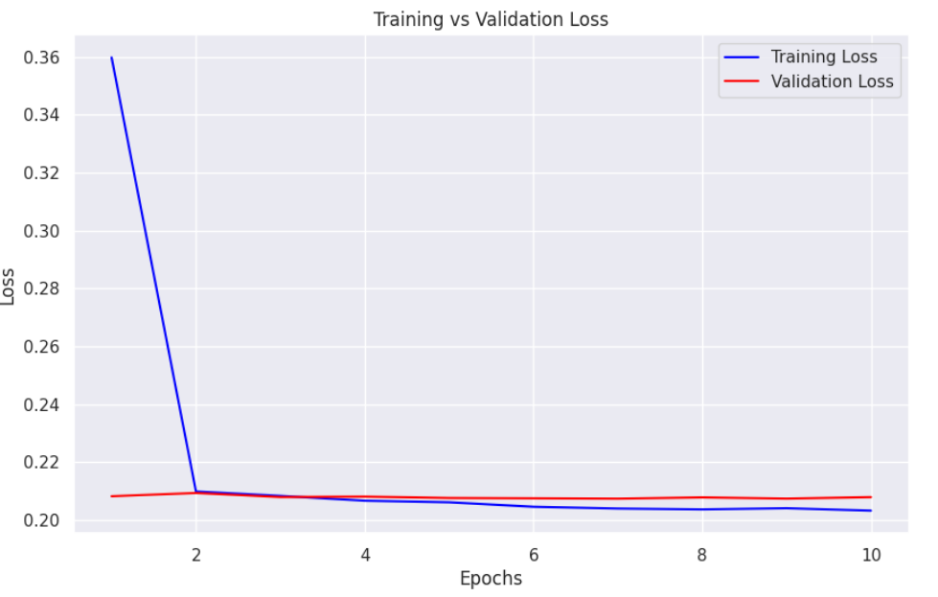
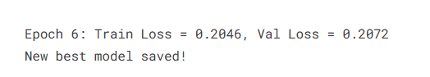
CNN Model with Images
Loss Graph: Training and Validation
CNN Model Details:
Number of Epochs = 10
Optimizer = Adam
Learning Rate Scheduler = ReduceLROnPlateau
(Reduces LR when validation loss stops improving)
4. Loss Function = RMSE Loss
5. Activation Function = ReLU
CNN Model Architecture:
Input (batch_size, 3, 224, 224)
↓
Conv1: 3 → 32 channels, kernel=3x3, stride=1, padding=1
Pool (Pooling: MaxPool2D(2x2, stride=2) )
↓
Conv2: 32 → 64 channels, kernel=3x3, stride=1, padding=1
Pool (Pooling: MaxPool2D(2x2, stride=2) )
↓
Conv3: 64 → 128 channels , kernel=3x3, stride=1, padding=1
Pool (Pooling: MaxPool2D(2x2, stride=2) )
↓
Fully Connected Layers
FC1: 100,352 → 512 (ReLU activated)
↓
Dropout: 50% probability
↓
FC2: 512 → 1 (Linear output)
Results:
Training RMSE = 0.2046
Validation RMSE = 0.2072
RMSE of 20.72 > Baseline (20.6)

Slide 23
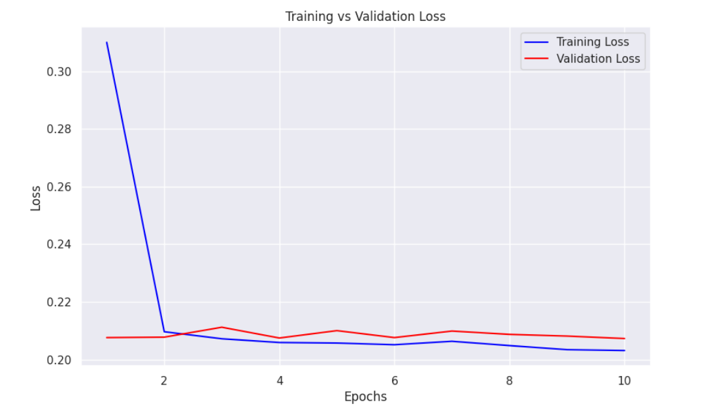

CNN Model with Images
Loss Graph: Training and Validation
CNN Model Details:
Number of Epochs = 10
Optimizer = AdamW
Learning Rate Scheduler = ReduceLROnPlateau
(Reduces LR when validation loss stops improving)
4. Loss Criteria = RMSE Loss
5. Activation Function = ReLU
CNN Model Architecture: (Same as before)
Observation:
We can observe that AdamW optimizer there is no
significant changes in validation loss but in training loss it is effective
Results:
Training RMSE = 0.2031
Validation RMSE = 0.2073
RMSE of 20.73 > Baseline (20.6)

Slide 24


CNN Model with Images
Loss Graph: Training and Validation
Advance CNN Model Architecture:Epochs = 10, Optimizer = AdamW and Activation Function = ReLU
Input (batch_size, 3, 224, 224)
↓
Conv1 : 3 → 32 channels (Conv2D) → BatchNorm → ReLU → MaxPool(2x2)
↓
Conv2: 32 → 64 channels → BatchNorm → ReLU → MaxPool
↓
Conv3: 64 → 128 channels → BatchNorm → ReLU → MaxPool
↓
Conv4: 128 → 256 channels → BatchNorm → ReLU → MaxPool
(All with 3x3 kernels with padding=1)
↓
Adaptive Pooling & Flattening
Global Average Pooling: Reduces final conv output (256×14×14) → 256×1×1
↓
Flatten: Converts 3D tensor → 256-dim vector
↓
Fully Connected Layers
FC1: 256 → 512 (BatchNorm + ReLU)
↓
Dropout: 50% probability
↓
FC2: 512 → 1 (Linear output)
Results:
Training RMSE = 0.2062
Validation RMSE = 0.2085
RMSE of 20.85 > Baseline (20.6)

Slide 25


CNN Model with Images and Metadata
Loss Graph: Training and Validation
CNN Model Details:
Number of Epochs = 10
Optimizer = AdamW
Learning Rate Scheduler = ReduceLROnPlateau
4. Loss Criteria = RMSE Loss
5. Activation Function = ReLU
CNN Model Architecture:
Image Pathway
Input (3×224×224) → [Conv3×3 → BN → ReLU → MaxPool] ×3 → Flatten → FC512 → ReLU → Dropout → FC256
↓
Metadata Pathway
Metadata (N features) → FC128 → ReLU → Dropout → FC64
↓
Combined Processing
Concat(Image_256, Metadata_64) → FC128 → ReLU → FC1 (Regression Output)
Results:
Training Loss:0.3593
Validation Loss:0.3564
RMSE of 35.64 > Baseline (20.6)

Slide 26

ResNet50 Model with Images
Loss Graph: Training and Validation
ResNet50 Model Details:
Number of Epochs = 10
Optimizer = AdamW
Learning Rate Scheduler = ReduceLROnPlateau
4. Loss Criteria = RMSE Loss
5. Activation Function = ReLU
ResNet50 Model Architecture:
Input (224,224)
↓
Backbone: Pretrained ResNet50 (ImageNet weights)
↓
ResNet50 Feature Extraction
↓
conv1 → bn1 → relu → maxpool → layer1-4 (Bottleneck Layers)→ avgpool
↓
Custom Regression Head
↓
Sequential (
Linear(2048 → 512) → ReLU → BatchNorm1d → Dropout(0.4),
Linear(512 → 128) → ReLU → BatchNorm1d → Dropout(0.3),
Linear(128 → 1) )
Results:
Validation Loss = ~0.1829
RMSE of 18.29 > Baseline (20.6)

Slide 27


ResNet50 Model with Images and Metadata
Loss Graph: Training and Validation
Results:
Validation Loss = ~0.1801
RMSE of 18.01 < Without Metadata (18.29) < Baseline (20.6)

Slide 28


Vision Transformer
Understanding Vision Transformer:
Image Patching
Split input image into fixed-size patches. It treats image regions as sequence tokens
2. Patch Embedding
Flatten patches into vectors. Linearly project to lower dimensions via a trainable layer. A Sequence of patch embeddings
3. Positional Encoding
Add learnable positional embeddings to retain spatial information
4. Classification Token
Prepend a learnable [CLS] token to the patch sequence
5. Transformer Encoder
Process sequence through stacked encoder blocks. Multi-head Self-Attention, MLP layers and
Layer Norm & Skip Connections
6. Classification Head
Use the [CLS] token’s output for prediction. A shallow MLP maps features to class probabilities.
Pre-train: On large datasets (e.g., ImageNet-21k) with supervised loss.
Source: https://arxiv.org/pdf/2010.11929

Slide 29

ViT: Base Model (vit_b_16) with Images
Loss Graph: Training and Validation
ViT Model Architecture:
Input Image (224x224)
↓
ViT Backbone (mostly frozen, last 4 blocks trainable)
↓
Feature Extraction (768 features)
↓
Final Layers:
768 → 512 (ReLU + LayerNorm + Dropout 0.3)
512 → 256 (ReLU + LayerNorm + Dropout 0.2)
256 → 1 (Sigmoid)
↓
Output (0-1 score)
Epochs: 11 (11th crashed due to memory)
Results:
Training Loss: 0.1735
Validation Loss: 0.1772
RMSE of 17.72 < Baseline (20.6)

Slide 30

SWIN Transformer
Understanding SWIN Transformer:
Hierarchical Design
Enables multi-scale feature learning like CNNs
2. Shifted Window Self-Attention
Splits images into non-overlapping local windows. Shifted windows in consecutive layers enable cross-window communication.
3. Patch Merging
Merges 2×2 neighboring patches between stages.
4. Window-Based Multi-Head Attention
Computes self-attention locally within windows (vs global in ViT)
5. Multi-Scale Feature Learning
High-resolution local features. Low-resolution global context
Source: https://arxiv.org/pdf/2103.14030

Slide 31

Swin Transformer with Images and Metadata
Swin Model Architecture:
Input Image (256x256)
↓
Swin-V2-B Backbone (mostly frozen, last 2 stages trainable)
↓
Feature Extraction (1024 features)
↓
Metadata Input (12 features)
↓
Metadata Processing:
12 → 64 (ReLU + LayerNorm + Dropout 0.2)
64 → 32
↓
Combined Features (1024 + 32 = 1056)
↓
Final Layers:
1056 → 512 (ReLU + LayerNorm + Dropout 0.3)
512 → 256 (ReLU + LayerNorm + Dropout 0.2)
256 → 1 (Sigmoid)
↓
Output (0-1 score)
Best RMSE: 17.78 ± 0.23
Results:
Training Loss: 17.12
Validation Loss: ~17.78
RMSE of 17.78 < Baseline (20.6)

Slide 32

OpenAI Clip Model with Images
Loss Graph: Training and Validation
Input Image ─────► CLIP ViT-B/32 ────► Image Features (512) Features (512)
(fine-tuned) │
▼
Image Features (512)
│
▼
Dense + Norm + ReLU (256)
│
▼
Dense + Norm + ReLU (128)
│
▼
Dense + Sigmoid
│
▼
Pawpularity Score (0-1)
Results:
Validation Loss: 0.1772
RMSE of 17.72 < Baseline (20.6)

Slide 33

OpenAI Clip Model with Images and Metadata
Input Image ─────► CLIP ViT-B/32 ────► Image Features (512)
(fine-tuned) │
▼
Concatenation (544)
▲
│
Metadata (12) ────► Dense + Norm ────► Features (32)
+ ReLU + Dropout
Combined Features (544)
│
▼
Dense + Norm + ReLU (256)
│
▼
Dense + Norm + ReLU (128)
│
▼
Dense + Sigmoid
│
▼
Pawpularity Score (0-1)
Results:
Validation Loss: 0.1735
RMSE of 17.35 < Baseline (20.6)
BEST EPOCH FOLD 3 (16.98)

Slide 34


DeiT-Tiny Transformer Model with Images
Loss Graph: Training and Validation
DeiT Model Details:
1. Model used: deit_tiny_patch16_224
2. Optimizer = AdamW
3. Learning Rate Scheduler = ReduceLROnPlateau
4. Loss Criteria = RMSE Loss
5. Activation Function = ReLU
DeiT Architecuture: Pretrained weights loaded for transfer learning
Input Image (224x224)
↓
Unfreezed last 2 layers, freezed all other
↓
Feature extraction (192)
↓
Linear Layer (192,512), BatchNorm1d, ReLU
Dropout
↓
Linear Layer (512,256), Relu, Dropout
↓
Linear Layer (256,1)
Feature transformation: 192 → 512 → 256 → 1 dimensions
Results:
Training Loss: 0.203
Validation Loss: 0.2072
RMSE of 20.72 > Baseline (20.6)

Slide 35
Comparison of models on the basis of Evaluation Metric Result
Models Trained | RMSE Results
MLP (Metadata) | 20.72
CNN (Images) | 20.72
CNN (Images + Metadata) | 35.6
Resnet50 (Images) | 18.29 +- 0.0024
Resnet50 (Images + Metadata) | 18.01 +- 0.0043
Vision transformer (Images) | 17.71
Swin Transformer (Images + Metadata) | 17.78 +- 0.23
DeiT –Tiny (Images) | 20.72
OpenAI Clip (Images) | 17.72
OpenAI Clip (Images + Metadata) | 17.35 +- 0.0022 (Best Score 16.98)

Slide 36


Slide 37


Slide 38
Conclusion
OpenAI Clip model has achieved the lowest RMSE value = 17.35 which is also lower than the Baseline provided in the challenge.
After performing with different scenarios, metadata and image together as the input data has resulted in better performance.
Models still performing poorly overall. (High RSME)
CNN shallow neural network does not work well with the task
Vision Transformer model architectures worked around well with image task.
Training transformers require higher computation resources thus more time.

Slide 39
Challenges
The Pawpularity Score provided in the data is not accurate enough and the algorithm used is not disclosed, therefore, achieving more accurate results was challenging.
Trying different models does not lead to very high significant difference in the RMSE value which suggest that the target value is not accurate.
Dataset subjectivity leads to bad models.
Future Work
Pawpularity score can be calculated again on different basis which can improve the performance of predicting the user behavior.
More models can be researched later and create an ensemble model.

Slide 40
Sources
https://huggingface.co/docs/transformers/en/model_doc/deit
https://huggingface.co/docs/transformers/en/model_doc/vit
https://fastai1.fast.ai/vision.learner.html
https://arxiv.org/pdf/2103.14030
https://arxiv.org/abs/2012.12877
https://arxiv.org/pdf/2012.12877
https://www.kaggle.com/competitions/petfinder-pawpularity-score/discussion/301686

Slide 41

THANK YOU

